Slide 1

Module 01
Introduction to Linux

Slide 2
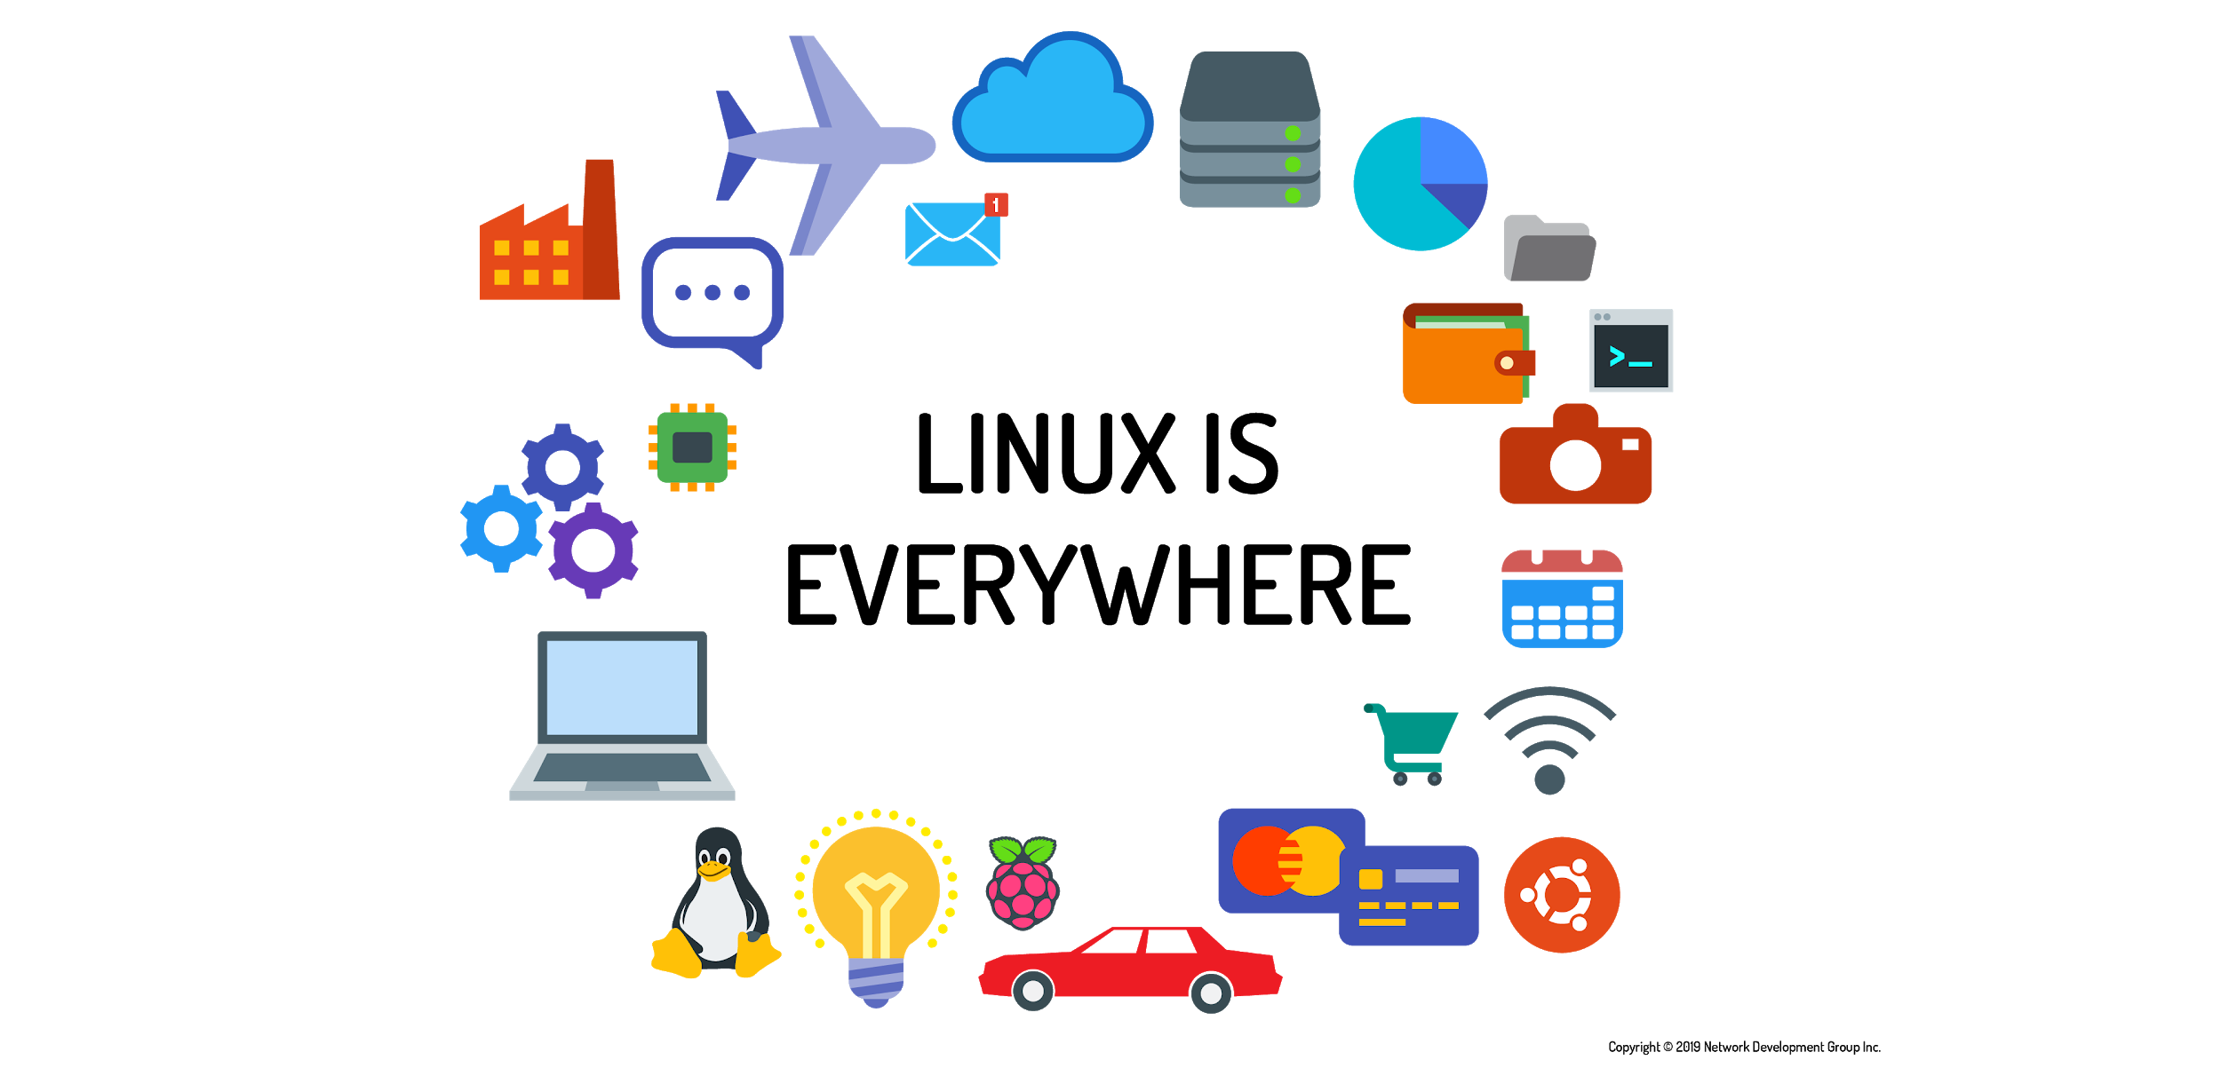

Linux is Everywhere!
Linux is everywhere, Linux jobs are everywhere, there is a shortage of Linux talent, and, Linux skills are in demand in just about every industry and job category on the planet.

Slide 3
Linux is a Kernel
Linux means the kernel of the system, which is the central controller of everything that happens on the computer.
Linux is a combination of software called GNU/Linux, which defines the operating system.
GNU is the free software that provides open source equivalents of many common UNIX commands.
The Linux part of this combination is the Linux kernel, which is the core of the operating system.
The story of Linux begins with UNIX, an operating system developed at AT&T Bell Labs in the 1970s.
UNIX is written in the C language.

Slide 4
Linux is a Kernel
Linux started in 1991 as a hobby project by Linus Torvalds, a Finnish born computer scientist studying at the University of Helsinki.
The GNU Project was developed Linux by Richard Stallman in 1983.
Linux programmers were able to incorporate the GNU tools to provide a complete operating system.

Slide 5
Linux is Open Source
Historically, most software has been issued under a closed-source license.
This means that you get the right to use the executable program or machine code, but cannot see the source code.
The development of Linux closely parallels the rise of open source software.
The open source philosophy is that you have a right to obtain the software source code and to modify it for your own use.

Slide 6
Linux Has Distributions
A distribution refers to the Linux kernel, tools, and suite of applications that come bundled together.
Take Linux and the GNU tools, add some user-facing applications like a web browser and an email client, and you have a full Linux system.
There are distributions suited to every imaginable purpose.
There are distributions that focus on running servers, desktops, or even industry-specific tools like electronics design or statistical computing.

Slide 7
Linux Embraces the CLI
There are two basic types of interfaces available that allow you to interact with the operating system.
The typical computer user today is most familiar with a graphical user interface (GUI).
In a GUI, applications present themselves in windows that can be resized and moved around.
There are menus and tools to help users navigate.
The second type of interface is the command line interface (CLI), a text-based interface to the computer.
The CLI relies primarily on keyboard input.

